Slide 1



PYTHON LAB
Video Submission
BY:
Riya Sharma
Kunal Sadana

Slide 2
Agenda:
Understanding the Problem Statement
Solution Approach
Brute-Force Method
Optimised Method
Python Implementation

Slide 3
Problem Statement
Write a program that finds two elements such that their sum is closest to zero from a given list that can contain positive and negative integers.
Test Case 1
Sample Input: [-4, 7, 6, 2, -5]
Sample Output: (-5, 6)
Test Case 2
Sample Input: [-50, 34, -19, 24, 33, 10, -46, -38]
Test Case 3
Sample Input: [-7, -5, -10, 0, -1, -15, -13]
Sample Output: (-38, 34)
Sample Output: (-1, 0)

Slide 4
Solution 1: Brute-Force Approach
Create a ‘min_sum’ variable and initialise it with 1000000000.
Loop through the list using nested loops.
Outer loop ‘i’ runs from first index to second to last index of the list.
Inner loop ‘j’ runs from ith index to last index of the list.
For every element present at i^{th} and j^{th} index check if absolute sum of the elements is less than min_sum.
If yes, then replace the value of min_sum with sum of the elements.
Store the values of i and j in some variable ‘a’ and ‘b’.
After the loop ends, return the elements present at a^{th} and b^{th} index.
Time Complexity: O(n²)
Limitations: Solution is not fast and efficient. Time Complexity is too high.

Slide 5
Solution 2: Two-Pointers Approach
Create a ‘min_sum’ variable and initialise it with 1000000000.
Sort the list using Inbuilt sort function.
Create variables ‘l’ and ‘r’ for left and right pointers respectively. Initialise l with zero and r with length of the given list minus 1.
Run a while loop with the given condition that l < r .
Conditions to be checked:
For every element present at l^{th} and r^{th} index check if absolute sum of the elements is less than min_sum.
If yes, then replace the value of min_sum with sum of the elements.
Store the values of l and r in some variable ‘i’ and ‘j’.
If min_sum equals zero, break the loop.
If sum of elements is less than zero, increment left pointer l with one; Else increment right pointer r with one.
After the loop ends, return the elements present at i^{th} and j^{th} index.
Time Complexity: O(nlogn)

Slide 6
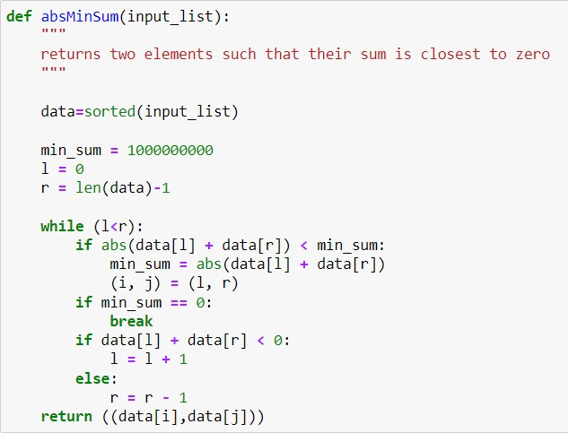
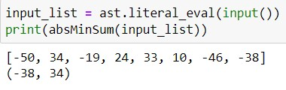
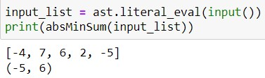
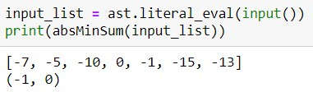
PYTHON Implementation
Test Case 1
Test Case 2
Test Case 3

Slide 7
Thank You!

